Slide 1

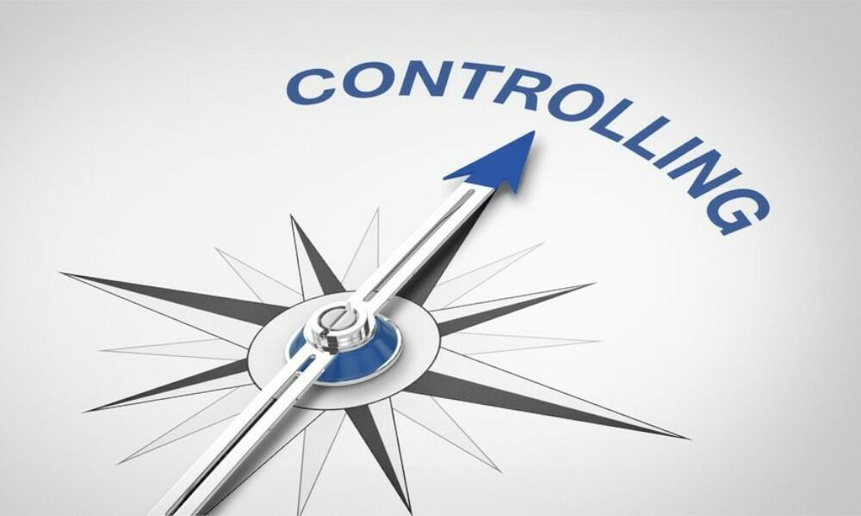

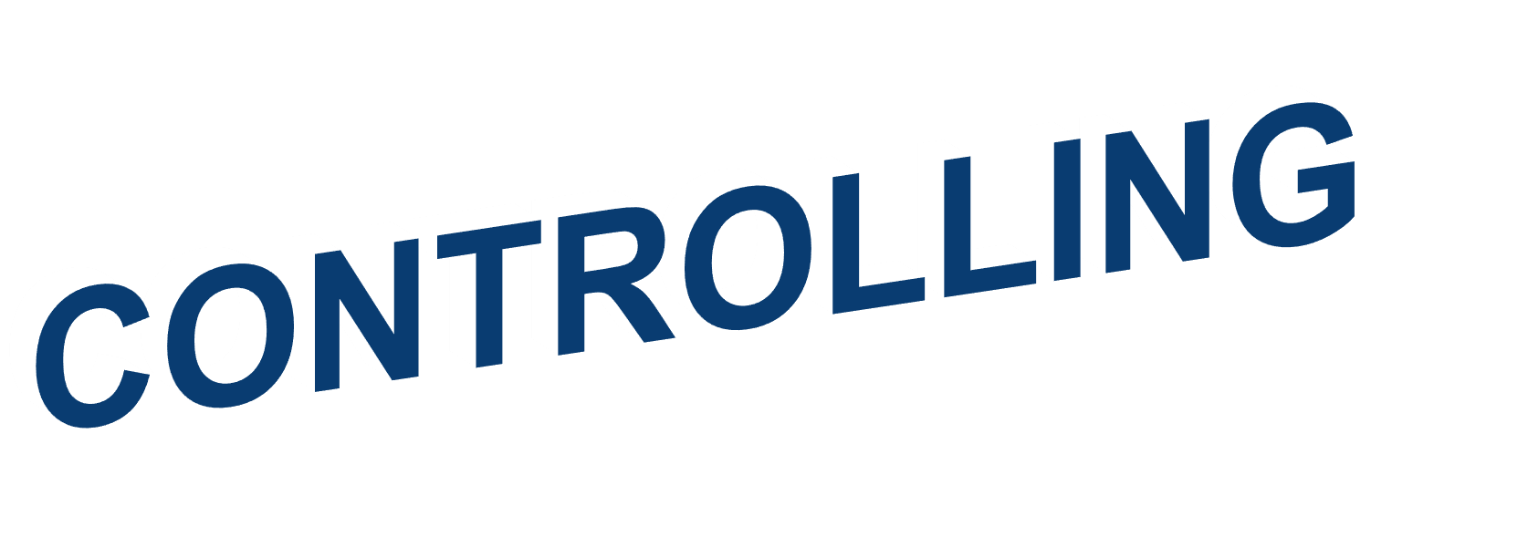




Slide 2













Explain the nature and importance of control.
Describe the three steps in the control process.
Explain how organizational and employee
performance are measured.
Describe tools used to measure organizational performance.
Discuss contemporary issues in control.
01
Jens Martensson

Slide 3
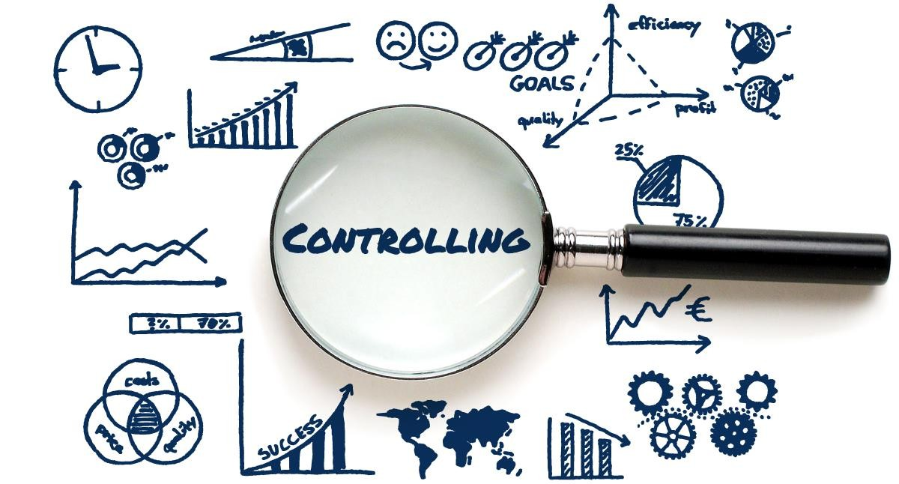
WHAT IS CONTROLLING?
Controlling – the process of monitoring, comparing, and correcting work performance.
Why is control important?
01
Jens Martensson3

Slide 4
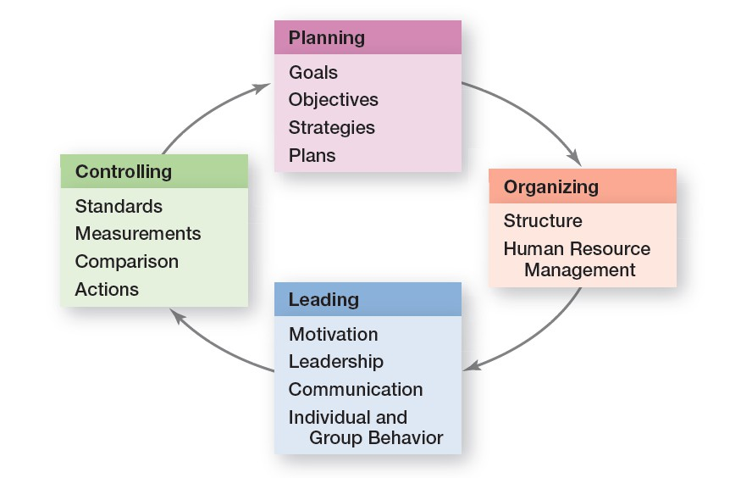
PLANNING-CONTROLLING LINK
02
Jens Martensson4

Slide 5
THE VALUE OF CONTROL FUNCTION
Empowering employee
Planning
Protecting the workplace
02
Jens Martensson4

Slide 6
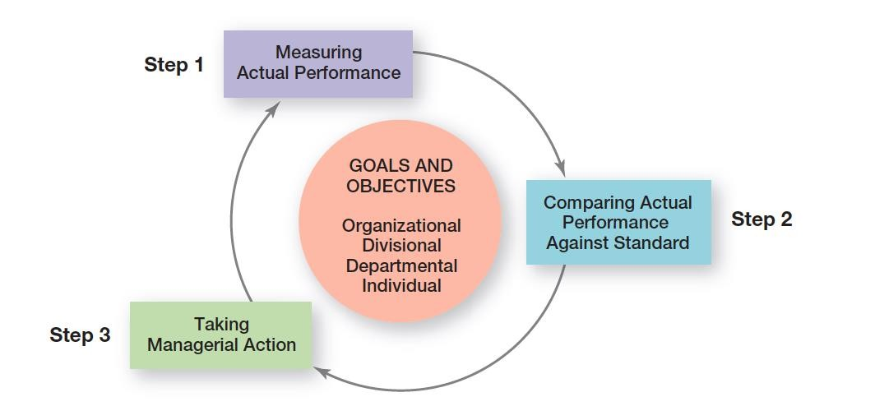
THE CONTROL PROCESS
03
Jens Martensson6

Slide 7
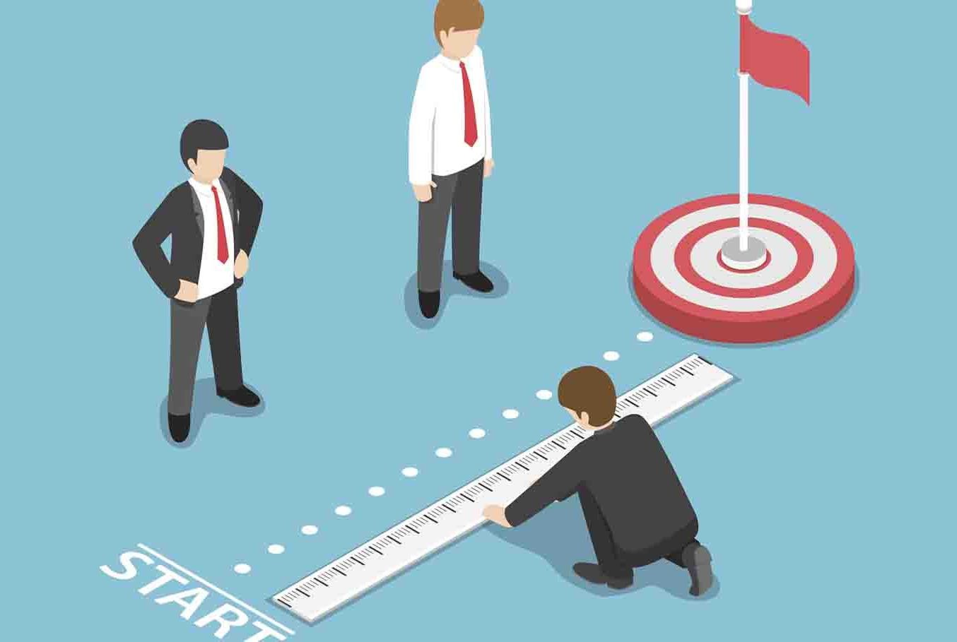
STEP 1: MEASURING ACTUAL PERFORMANCE
WHAT?
Human
Finance
Manufacturing
Information
- ….
04
Jens Martensson7

Slide 8
STEP 1: MEASURING ACTUAL PERFORMANCE
How We Measure – personal observations, statistical reports, oral reports, and written reports.
What We Measure – what is measured is probably more critical to the
control process than how it’s measured.
Which one is more important,
the “How” or the “What”?
04
Jens Martensson7

Slide 9
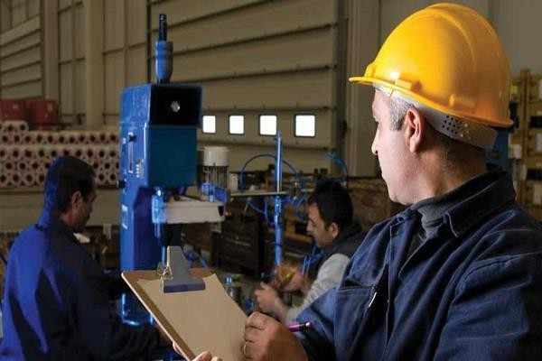
STEP 1: MEASURING ACTUAL PERFORMANCE
Sources of information
Personal observation
05
Jens Martensson9

Slide 10
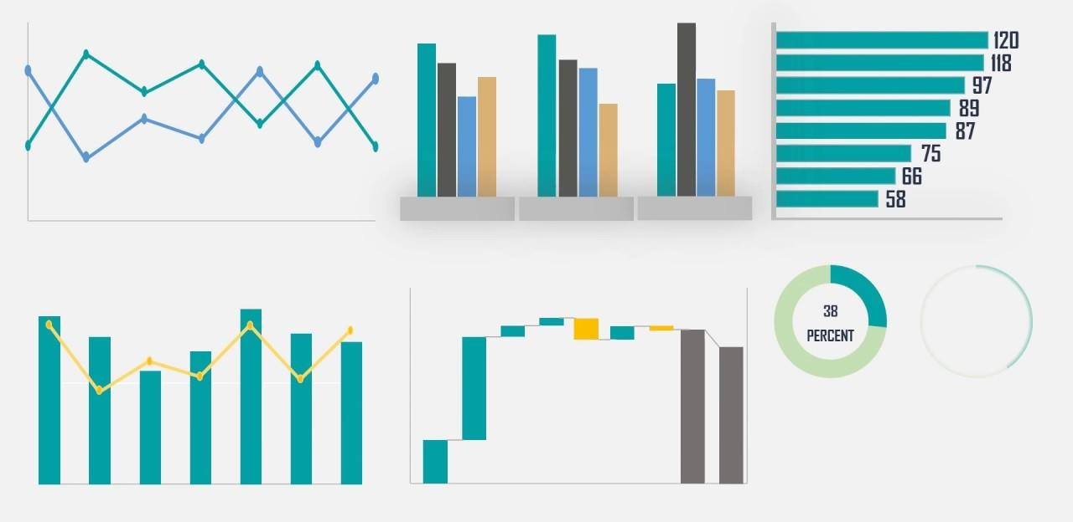
STEP 1: MEASURING ACTUAL PERFORMANCE
Sources of information
Báo cáo thống kê (statistical report)
05
Jens Martensson9

Slide 11

STEP 1: MEASURING ACTUAL PERFORMANCE
Sources of information
Personal observation
Statistical report
Oral report
Written report
05
Jens Martensson9

Slide 12
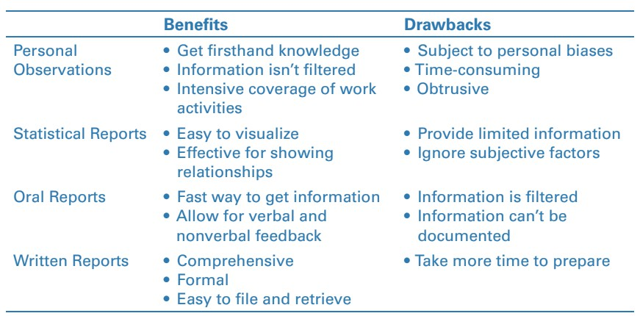
STEP 1: MEASURING ACTUAL PERFORMANCE
05
Jens Martensson9

Slide 13
STEP 2: COMPARING ACTUAL PERFORMANCE AGAINST THE STANDARD
Determining the degree of variation between actual performance and the standard.
Range of variation – the acceptable parameters of variance between actual performance and the standard.
06
Jens Martensson13

Slide 14
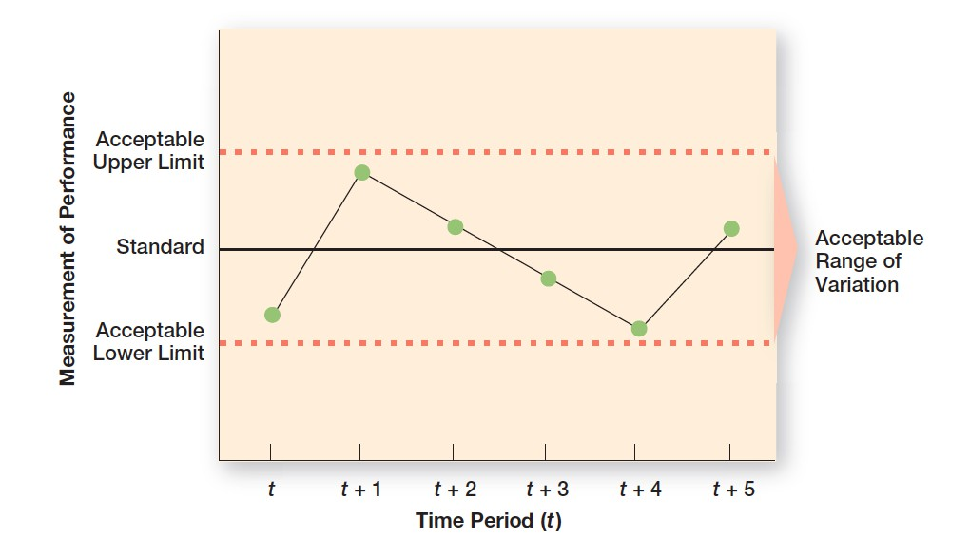
STEP 2: COMPARING ACTUAL PERFORMANCE AGAINST THE STANDARD
07
Jens Martensson14

Slide 15
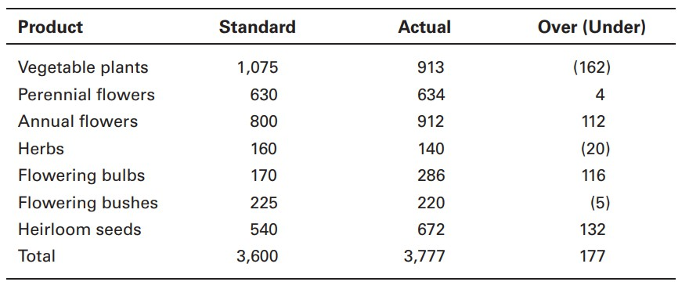
STEP 2: COMPARING ACTUAL PERFORMANCE AGAINST THE STANDARD
08
Jens Martensson15

Slide 16
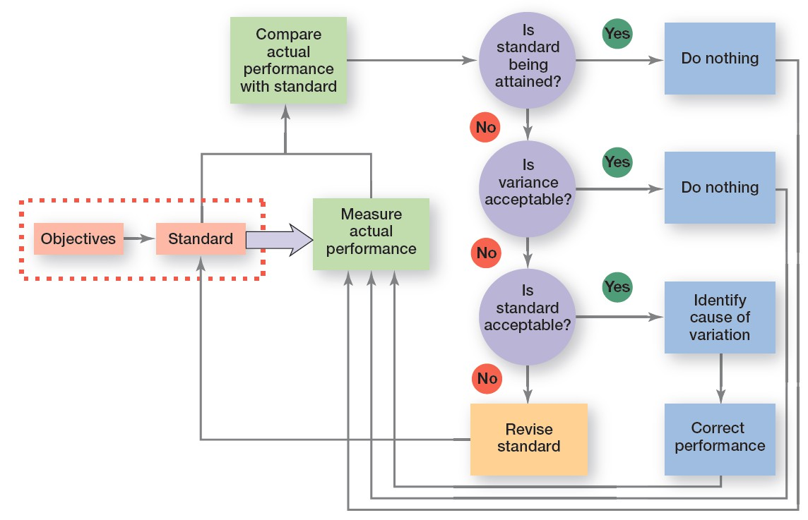
STEP 3: TAKING MANAGERIAL ACTION
10
Jens Martensson16

Slide 17
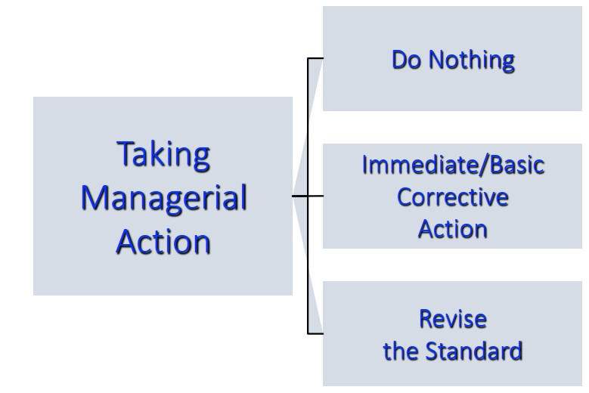
STEP 3: TAKING MANAGERIAL ACTION
09
Jens Martensson17

Slide 18
STEP 3: TAKING MANAGERIAL ACTION
Immediate corrective action – corrective action that corrects problems at once in order to get performance back on track.
Basic corrective action – corrective action that looks at how and why performance deviated before correcting the source of deviation.
Revise the Standard – if performance consistently exceeds the goal, then a manager should look at whether the goal is too easy and needs to be raised.
Managers must be cautious about revising a standard downward.
09
Jens Martensson17

Slide 19

STEP 3: TAKING MANAGERIAL ACTION
09
Jens Martensson17

Slide 20
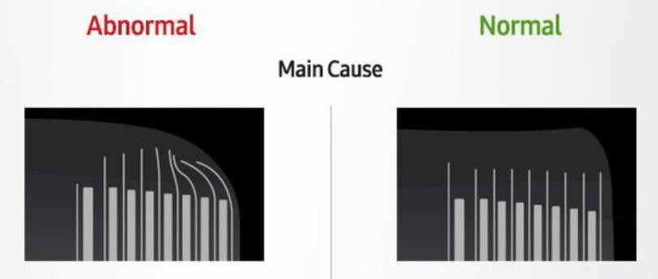
STEP 3: TAKING MANAGERIAL ACTION
09
Jens Martensson17

Slide 21
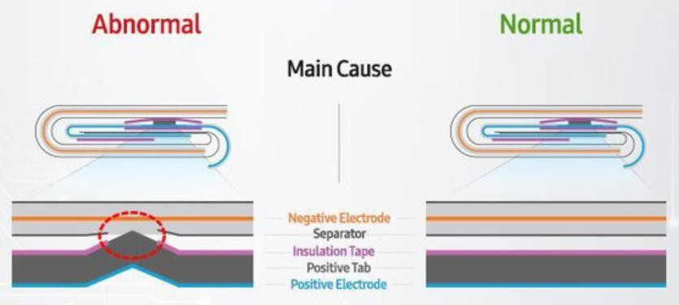
STEP 3: TAKING MANAGERIAL ACTION
09
Jens Martensson17

Slide 22
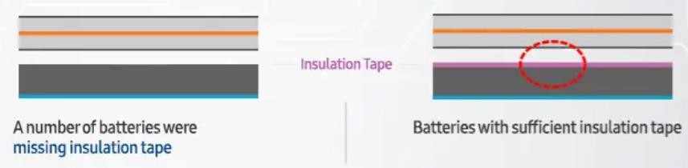
STEP 3: TAKING MANAGERIAL ACTION
09
Jens Martensson17

Slide 23
MEASURES OF ORGANIZATIONAL PERFORMANCE
Performance – the end result of an activity.
Organizational performance – the accumulated results of all the organization’s
work activities.
Productivity – the amount of goods or services produced divided by the inputs needed to generate that output.
Organizational effectiveness – a measure of how appropriate organizational goals are and how well those goals are being met.
Jens Martensson23

Slide 24
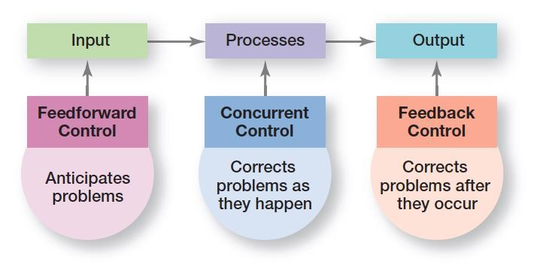
TYPES OF CONTROL
Jens Martensson23

Slide 25
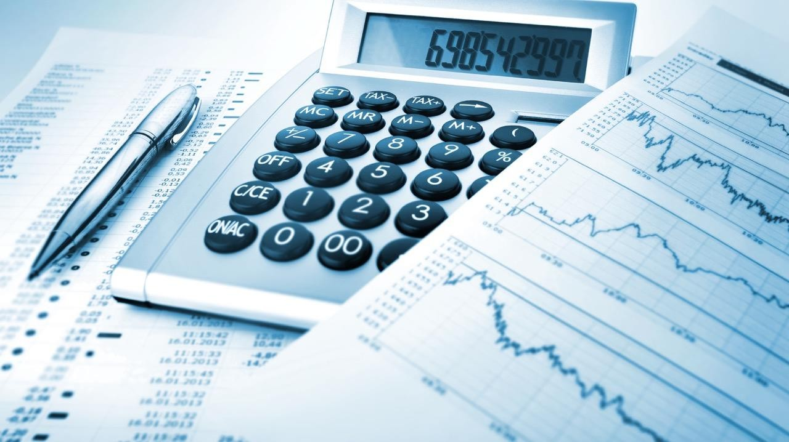
FINANCE CONTROL
- Ratio analysis
Liquidity
Leverage
Activity
Profitability
- Budget Analysis
Quantitative standards
Deviations
Jens Martensson23

Slide 26
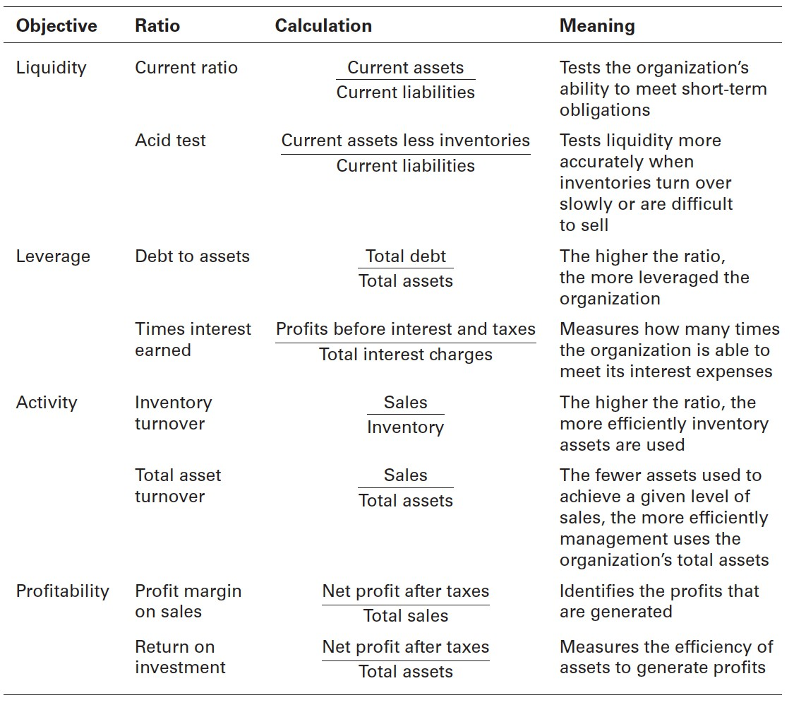
FINANCE CONTROL
Jens Martensson23

Slide 27
INFORMATION CONTROLS
(MIS) – a system used to provide management with needed information on a regular basis.
Data – an unorganized collection of raw, unanalyzed facts (e.g.,
an unsorted list of customer names).
Information – data that has been analyzed and organized such that it has value and relevance to managers.
Jens Martensson23

Slide 28
THE BALANCED SCORECARD
Balance scorecard: a performance measurement tool that examines more than
just the financial perspective.
Measures a company’s performance in four areas:
Financial
Customer
Internal processes
People/innovation/growth assets
Jens Martensson23

Slide 29
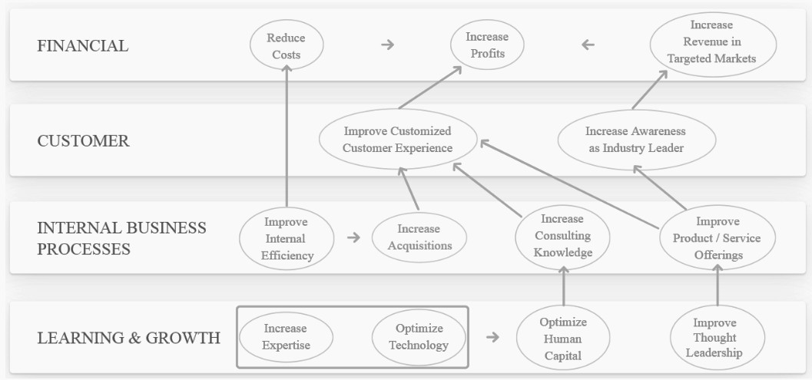
THE BALANCED SCORECARD
EXAMPLE
17
Jens Martensson29

Slide 30
CONTEMPORARY ISSUES IN CONTROL
Adjusting Controls for Cross-Cultural Differences and Global Turmoil
Workplace Privacy
Employee Theft
Workplace Violence
Controlling Customer Interactions
Corporate Governance
17
Jens Martensson29

Slide 31




“Every individual employee in an organization plays a role in controlling work activities.” Do you agree with this statement, or do you think control is something that only managers are responsible for? Explain.
31Jens Martensson

Slide 32


THANK YOU

